Slide 1
Channel Estimation Methods
Submitted by: Mahmoud Ramzy
Submitted to: Dr/Diaa & dr/hatem

Slide 2
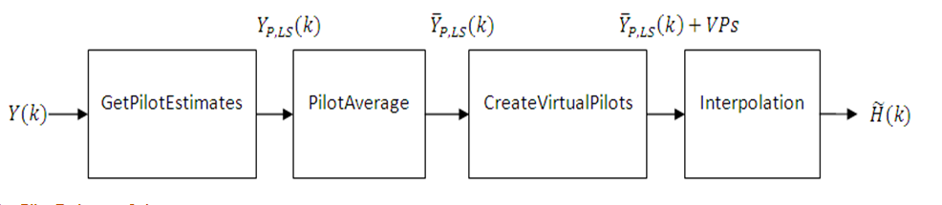
Channel Estimation process:

Slide 3
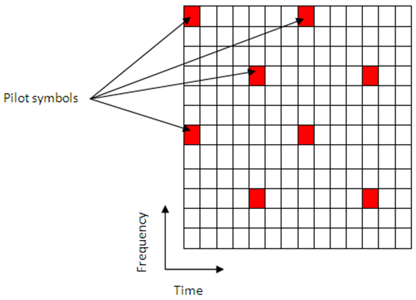
Get Pilot Estimates Subsystem:
The extraction of pilot symbols from
their known location within
the received subframe.
Pilot (reference symbols) should be
known for receiver to estimate
the CIR based on it.
There are 504 unique pilot sequences

Slide 4
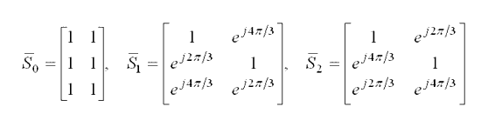
Pilot symbols generation:
The 2-D reference signal sequence is generated as:
There are 3 different 2-D orthogonal sequences
168 different 2-D pseudo-random sequences with c/s function of the PN sequence

Slide 5
Pilot Average Subsystem
There are 2 algorithms to minimize the effects of noise on the channel estimates.
Least Square Estimation (LS) | Minimum Mean Square Estimation (MMSE)
computationally simple: ( just multiplication ) | computationally complex: ( auto and cross covariance )
performance is not good | Better performance

Slide 6
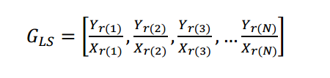
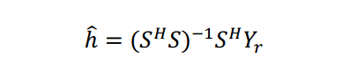
Least Square Estimation (LS):
It determines the CIR from the known transmitted reference symbols:
By solving:
h & G(Ls): the estimated channel impulse response (CIR).
Yr : represents the received pilot symbol values.
S &X : represents the known transmitted pilot symbol values.

Slide 7
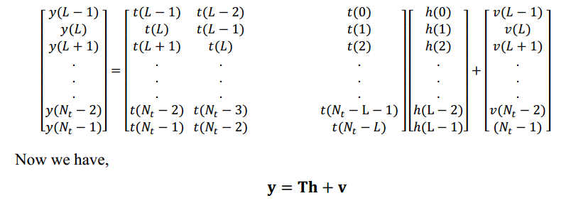
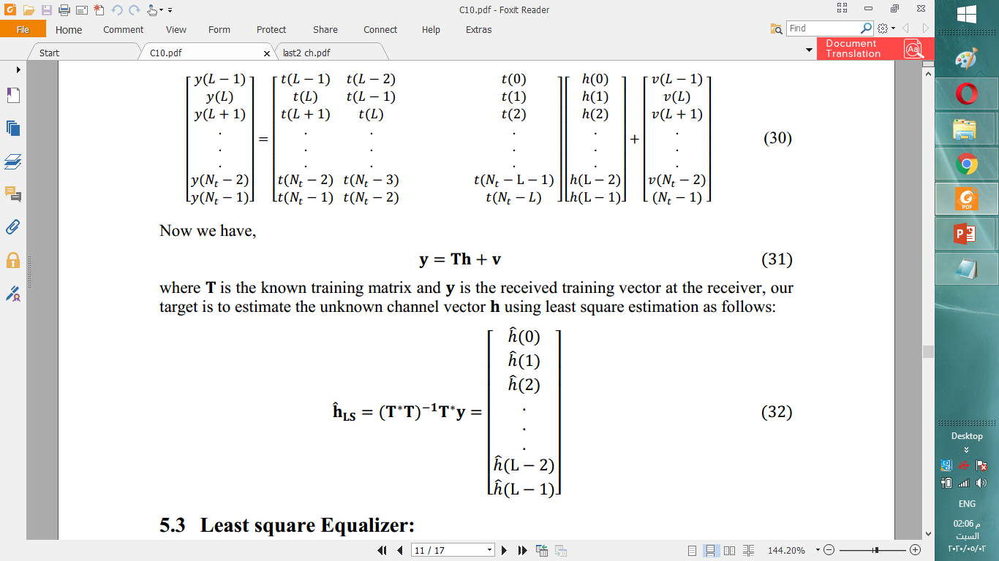
LS Calculation:

Slide 8
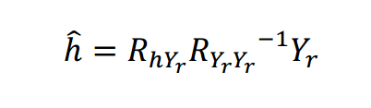
Minimum Mean Square Estimation (MMSE):
Another method toestimate the CIR is minimum mean
square estimator:
Here RYY is the auto covariance of vector Yr and RhY is the cross covariance of vectors h and Y.

Slide 9
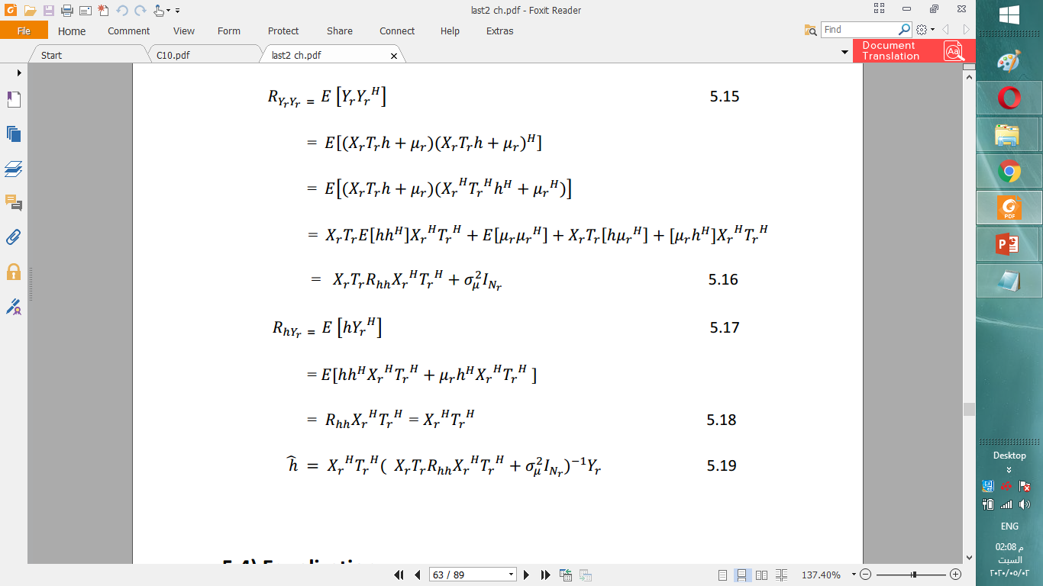
MMSE Calculation:

Slide 10
References:
https://www.diva-portal.org/smash/get/diva2:831559/FULLTEXT01.pdf
https://www.mathworks.com/help/lte/ug/channel-estimation.html
http://literature.cdn.keysight.com/litweb/pdf/ads2008/3gpplte/ads2008/LTE_DL_Pilot_(Downlink_Pilot_Generator).html

